Slide 1
Mixed Quantum-Classical Methods based on Exact Factorization
Daeho Han
Department of Chemistry,
University at Buffalo, SUNY
July 10, 2024

Slide 2
Outline
Conventional mixed quantum-classical (MQC) methods
The exact factorization (XF) formalism & its MQC variation
Coupled-trajectory (CT) MQC approach
Independent-trajectory XF methods
Implementation of the XF methods in Libra

Slide 3
Conventional mixed quantum-classical (MQC) methods

Slide 4
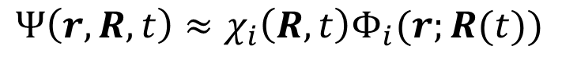
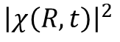

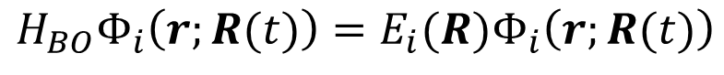

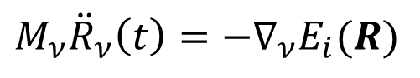
Effective potential energy surfaces in the MQC methods
In the mixed quantum-classical methods, nuclear and electronic degrees of freedom (DOF) are described separately: electrons are treated as quantum particles, and nuclei are approximated to classical particles.
The simplest form of the MQC approach is the Born-Oppenheimer molecular dynamics (BOMD) – molecular dynamics on the single potential energy surface (PES).
The classical ensemble of the particle reflects on the quantum nuclear distribution.
$$Ψ\left(r,R,t\right)≈χ_{i}\left(R,t\right)Φ_{i}(r;R(t))$$
$$\{$$
$$M_{ν}{\ddot{R}}_{ν}\left(t\right)=−∇_{ν}E_{i}(R)$$
$${\left|χ\left(R,t\right)\right|}^{2}$$
$$H_{BO}Φ_{i}\left(r;R(t)\right)=E_{i}(R)Φ_{i}\left(r;R(t)\right)$$
$$R$$

Slide 5


Effective potential energy surfaces in the MQC methods
Then how do we set the proper potential energies in the nonadiabatic regime?
Surface hopping
Ehrenfest
$$R$$
$$R$$
Stochastically determined adiabatic force
Mean-field force
↔ intuitively correct but discontinuous PES
↔ unphysical pathway and wrong branching ratio

Slide 6

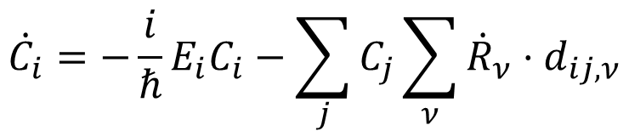
Decoherence correction in the MQC methods
“Overcoherence” problem: the decoherence is missing in the original electronic TDSE.
$${\dot{C}}_{i}=−\frac{i}{ℏ}E_{i}C_{i}−\sum_{j}{C_{j}\sum_{ν}{{\dot{R}}_{ν}⋅d_{ij,ν}}}$$
The population exchange only occurs when the nonadiabatic coupling (NAC) is finite.
The first term only change the phase of the adiabatic coefficient.
Without the decoherence correction, there could be long-lasting coherence.
$$R$$

Slide 7
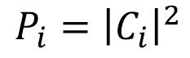
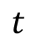
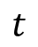
Decoherence correction in the MQC methods
“Overcoherence” problem: the decoherence is missing in the original electronic TDSE.
$${\dot{C}}_{i}=−\frac{i}{ℏ}E_{i}C_{i}−\sum_{j}{C_{j}\sum_{ν}{{\dot{R}}_{ν}⋅d_{ij,ν}}}$$
Traditional MQC
1
1
POP
$$t$$
$$P_{i}={\left|C_{i}\right|}^{2}$$
Actual dynamics
POP
$$R$$
$$t$$

Slide 8
Decoherence correction in the MQC methods
“Overcoherence” problem: the decoherence is missing in the original electronic TDSE.
$${\dot{C}}_{i}=−\frac{i}{ℏ}E_{i}C_{i}−\sum_{j}{C_{j}\sum_{ν}{{\dot{R}}_{ν}⋅d_{ij,ν}}}$$
Traditional MQC
2
POP
2
$$t$$
$$P_{i}={\left|C_{i}\right|}^{2}$$
Actual dynamics
POP
$$R$$
$$t$$

Slide 9
Decoherence correction in the MQC methods
“Overcoherence” problem: the decoherence is missing in the original electronic TDSE.
$${\dot{C}}_{i}=−\frac{i}{ℏ}E_{i}C_{i}−\sum_{j}{C_{j}\sum_{ν}{{\dot{R}}_{ν}⋅d_{ij,ν}}}$$
Traditional MQC
3
POP
3
$$t$$
$$P_{i}={\left|C_{i}\right|}^{2}$$
Actual dynamics
POP
$$R$$
$$t$$

Slide 10
Decoherence correction in the MQC methods
“Overcoherence” problem: the decoherence is missing in the original electronic TDSE.
0
$${\dot{C}}_{i}=−\frac{i}{ℏ}E_{i}C_{i}−\sum_{j}{C_{j}\sum_{ν}{{\dot{R}}_{ν}⋅d_{ij,ν}}}$$
Traditional MQC
4
4
Off-NAC region
POP
$$t$$
$$P_{i}={\left|C_{i}\right|}^{2}$$
Actual dynamics
Off-NAC region
POP
$$R$$
$$t$$

Slide 11
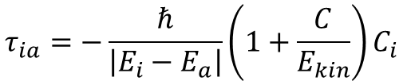
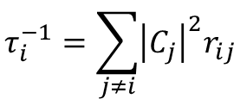
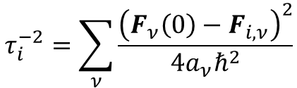
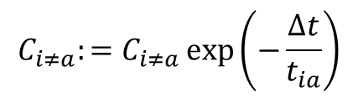
Effective potential energy surfaces in the MQC methods
To resolve this overcoherence problem, various decoherence-corrected methods have been developed. The decoherence correction has various types, which correct the electronic TDSE directly or decoherence times.
Simplified Decay of Mixing (SDM)
$$τ_{ia}=−\frac{ℏ}{\left|E_{i}−E_{a}\right|}\left(1+\frac{C}{E_{kin}}\right)C_{i}$$
$$C_{i≠a}:=C_{i≠a}\exp\left(−\frac{Δt}{t_{ia}}\right)$$
Granucci, G.; Persico, M. JCP. 2007, 126 (13), 134114.
A-FSSH
$$τ_{ij}^{−1}=\frac{δF_{ii}⋅\left(δR_{ii}−δR_{jj}\right)}{2ℏ}−\frac{2\left|d_{ji}⋅\left(E_{j}−E_{i}\right)\left(δR_{ii}−δR_{jj}\right)⋅v\right|}{ℏv⋅v}$$
Jain, A.; Alguire, E.; Subotnik, J. E. JCTC. 2016, 12 (11), 5256–5268.
Instantaneous Decoherence Approximation (IDA)
Nelson, T.; Fernandez-Alberti, S.; Roitberg, A. E.; Tretiak, S. JCP. 2013, 138 (22), 224111.
$$τ_{i}^{−2}=\sum_{ν}{\frac{{\left(F_{ν}\left(0\right)−F_{i,ν}\right)}^{2}}{4a_{ν}ℏ^{2}}}$$
Mean-field dynamics with stochastic decoherence (MFSD)
Bedard-Hearn, M. J.; Larsen, R. E.; Schwartz, B. J. JCP. 2005, 123 (23), 234106.
Decoherence-Induced Surface Hopping (DISH)
$$τ_{i}^{−1}=\sum_{j≠i}{{\left|C_{j}\right|}^{2}r_{ij}}$$
Jaeger, H. M.; Fischer, S.; Prezhdo, O. V. JCP. 2012, 137 (22), 22A545.

Slide 12
The exact factorization (XF) formalism &
its MQC variation

Slide 13
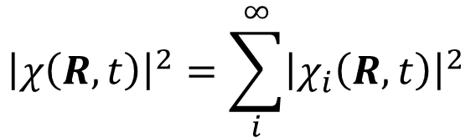
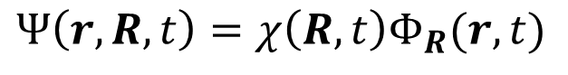

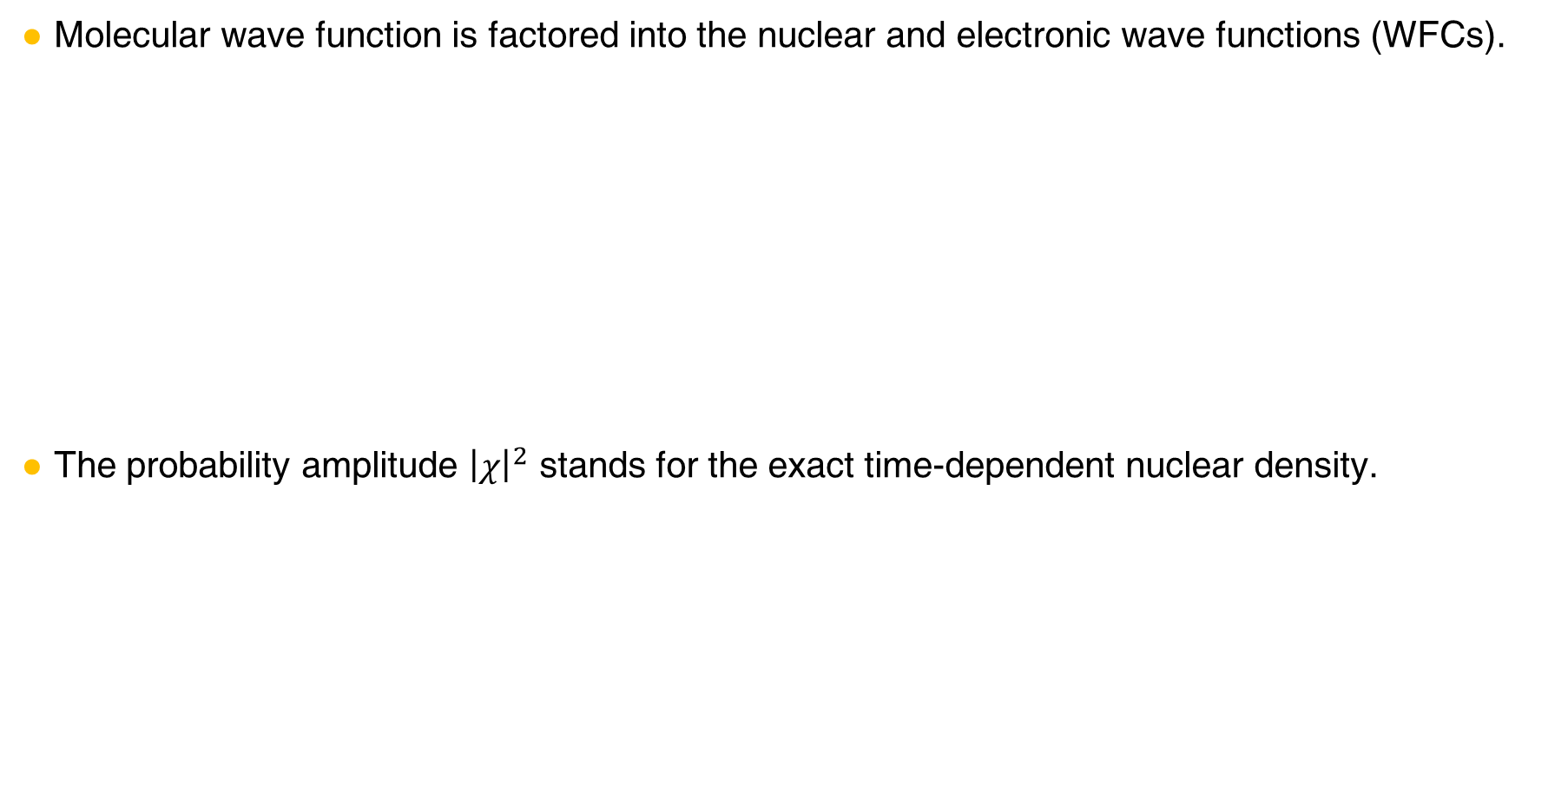

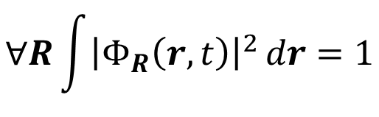
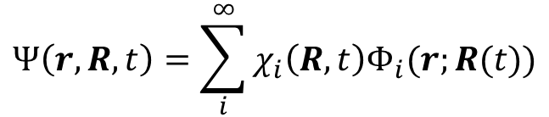
XF ansatz
Molecular wave function is factored into the nuclear and electronic wave functions (WFCs).
The probability amplitude ${\left|χ\right|}^{2}$ stands for the exact time-dependent nuclear density.
$$∀R\int{{\left|Φ_{R}\left(r,t\right)\right|}^{2}}dr=1$$
$$Ψ\left(r,R,t\right)=χ\left(R,t\right)Φ_{R}(r,t)$$
Partial Normalization Condition
$${\left|Ψ\left(r,R,t\right)\right|}^{2}drdR={\left|χ\left(R,t\right)\right|}^{2}dR ×{ \left|Φ_{R}\left(r,t\right)\right|}^{2}dr$$
Total probability
Marginal probability for $R$
Conditional probability for $r$ under $R$
cf. Born-Huang expansion
$${\left|χ\left(R,t\right)\right|}^{2}=\sum_{i}^{∞}{{\left|χ_{i}\left(R,t\right)\right|}^{2}}$$
$$Ψ\left(r,R,t\right)=\sum_{i}^{∞}{χ_{i}\left(R,t\right)Φ_{i}(r;R(t))}$$
Abedi, A.; Maitra, N. T.; Gross, E. K. U. PRL 2010, 105 (12), 123002.
Abedi, A.; Maitra, N. T.; Gross, E. K. U. JCP 2012, 137 (22), 22A530.

Slide 14

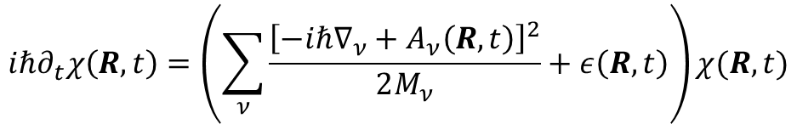
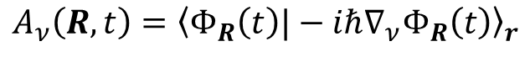
XF ansatz
Coupled XF equations
$$iℏ∂_{t}χ\left(R,t\right)=\left(\sum_{ν}{\frac{{\left[−iℏ∇_{ν}+A_{ν}\left(R,t\right)\right]}^{2}}{2M_{ν}}}+ε\left(R,t\right)\right)χ(R,t)$$
$$\{$$
$$iℏ∂_{t}Φ_{R}\left(r,t\right)=\left(H_{BO}\left(r,R\right)+U_{en}^{coup}\left[Φ_{R},χ\right]−ε(R,t)\right)Φ_{R}(R,t)$$
Time-dependent (TD) PES
$$ε\left(R,t\right)={\left\langle Φ_{R}\left(t\right)\left|H_{BO}+U_{en}^{coup}−iℏ∂_{t}\right|Φ_{R}\left(t\right)\right\rangle }_{r}$$
TD vector potential
$$A_{ν}\left(R,t\right)={\left\langle Φ_{R}\left(t\right)|−iℏ∇_{ν}Φ_{R}\left(t\right)\right\rangle }_{r}$$
Electron-nuclear correlation operator
$$U_{en}^{coup}\left[Φ_{R},χ\right]=\sum_{ν}{\frac{1}{M_{ν}}\left[\frac{{\left[−iℏ∇_{ν}−A_{ν}\left(R,t\right)\right]}^{2}}{2}+\left(\frac{−iℏ∇_{ν}χ}{χ}+A_{ν}(R,t)\right)⋅\left(−iℏ∇_{ν}−A_{ν}(R,t)\right)\right]}$$
Leading to Diagonal BO correction
Major electron-nuclear correlation
Abedi, A.; Maitra, N. T.; Gross, E. K. U. PRL. 2010, 105 (12), 123002.
Abedi, A.; Maitra, N. T.; Gross, E. K. U. JCP. 2012, 137 (22), 22A530.

Slide 15
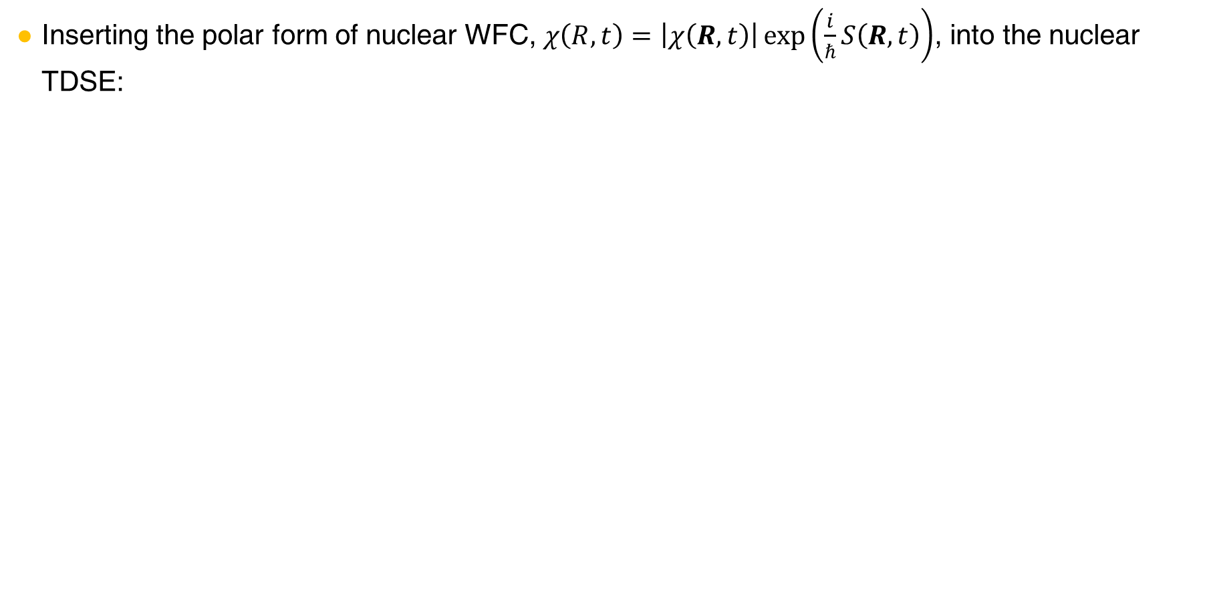
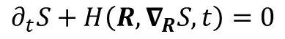
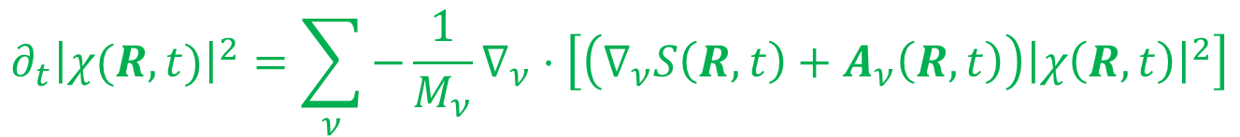
Towards the MQC equations
Inserting the polar form of nuclear WFC, $χ\left(R,t\right)=\left|χ\left(R,t\right)\right|\exp\left(\frac{i}{ℏ}S\left(R,t\right)\right)$, into the nuclear TDSE:
$$∂_{t}S\left(R,t\right)=−\sum_{ν}{\frac{{\left[∇_{ν}S\left(R,t\right)+A_{ν}\left(R,t\right)\right]}^{2}}{2M_{ν}}}−ε\left(R,t\right)+ℏ^{2}\sum_{ν}{\frac{1}{2M_{ν}}\frac{∇_{ν}^{2}|χ(R,t)|}{|χ(R,t)|}}$$
Real part
Quantum Hamilton-Jacobi equation
$$∂_{t}{\left|χ(R,t)\right|}^{2}=\sum_{ν}{−\frac{1}{M_{ν}}∇_{ν}⋅\left[\left(∇_{ν}S\left(R,t\right)+A_{ν}\left(R,t\right)\right){\left|χ\left(R,t\right)\right|}^{2}\right]}$$
Imaginary part
Continuity equation
→ Throw away
(Within MQC, we assume its solution, i.e., a delta function).
cf. Hamilton-Jacobi equation
$$∂_{t}S+H\left(R,∇_{R}S,t\right)=0$$
Min, S. K.; Agostini, F.; Gross, E. K. U. PRL. 2015, 115 (7), 073001.
Agostini, F.; Min, S. K.; Abedi, A.; Gross, E. K. U. JCTC. 2016, 12 (5), 2127–2143.

Slide 16
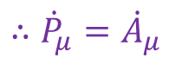
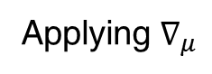
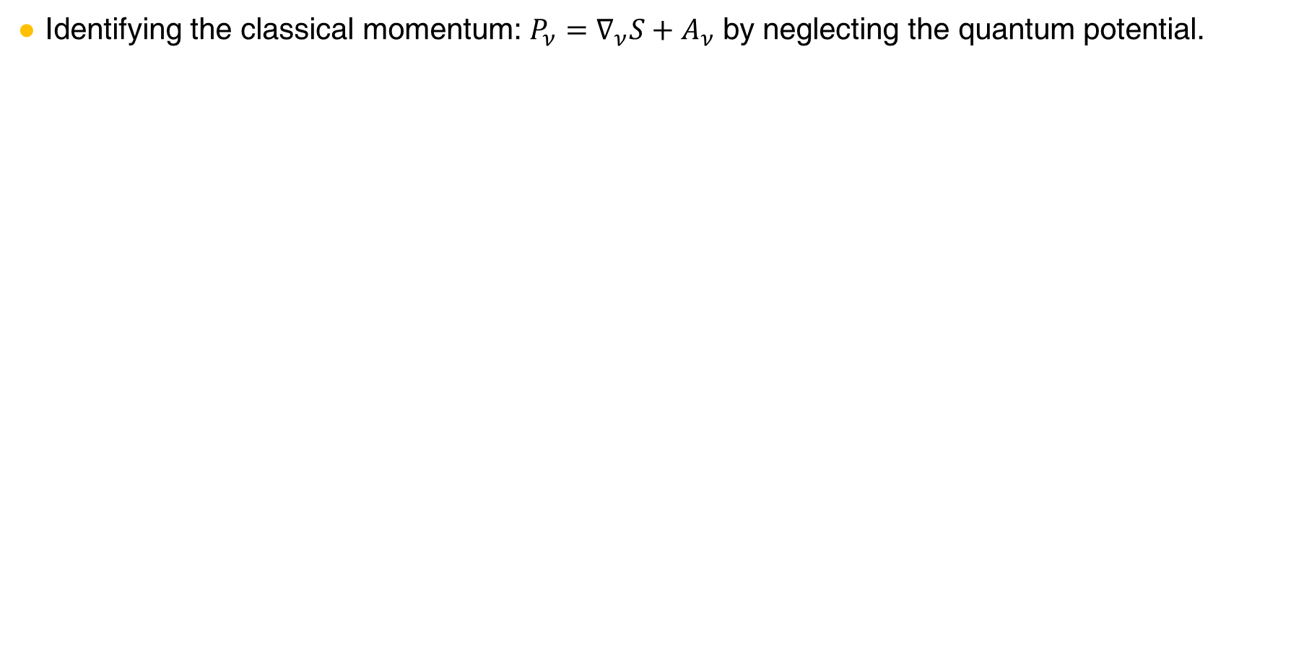
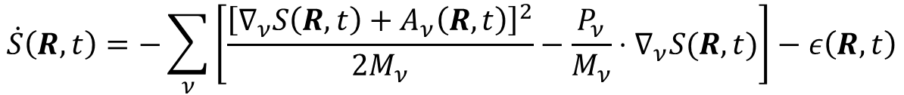
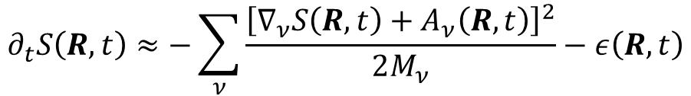

Towards the MQC equations
Identifying the classical momentum: $P_{ν}=∇_{ν}S+A_{ν}$ by neglecting the quantum potential.
$$∂_{t}S\left(R,t\right)≈−\sum_{ν}{\frac{{\left[∇_{ν}S\left(R,t\right)+A_{ν}\left(R,t\right)\right]}^{2}}{2M_{ν}}}−ε\left(R,t\right)$$
$$\dot{S}\left(R,t\right)=−\sum_{ν}{\left[\frac{{\left[∇_{ν}S\left(R,t\right)+A_{ν}\left(R,t\right)\right]}^{2}}{2M_{ν}}−\frac{P_{ν}}{M_{ν}}⋅∇_{ν}S(R,t)\right]}−ε\left(R,t\right)$$
In the Lagrangian frame
$$=−\sum_{ν}{\left[\frac{P_{ν}^{2}}{2M_{ν}}−\frac{P_{ν}}{M_{ν}}⋅\left(P_{ν}−A_{ν}\right)\right]}−ε\left(R,t\right)=−\left(−\sum_{ν}{\frac{P_{ν}^{2}}{2M_{ν}}}+ε\left(R,t\right)+\sum_{ν}{A_{ν}⋅\frac{P_{ν}}{M_{ν}}}\right)$$
Applying $∇_{μ}$
$∇_{μ}\left(\frac{d}{dt}S\right)=\frac{d}{dt}\left(∇_{μ}S\right)={\dot{P}}_{μ}−{\dot{A}}_{μ}=−∇_{μ}\left(ε\left(R,t\right)+\sum_{ν}{A_{ν}⋅\frac{P_{ν}}{M_{ν}}}\right)≔0$ (by setting the Gauge condition)
$$∴{\dot{P}}_{μ}={\dot{A}}_{μ}$$
under $ε\left(R,t\right)+\sum_{ν}{A_{ν}⋅\frac{P_{ν}}{M_{ν}}}=0$
Min, S. K.; Agostini, F.; Gross, E. K. U. PRL 2015, 115 (7), 073001.
Agostini, F.; Min, S. K.; Abedi, A.; Gross, E. K. U. JCTC 2016, 12 (5), 2127–2143.

Slide 17
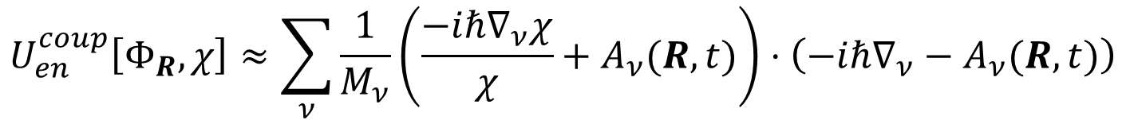
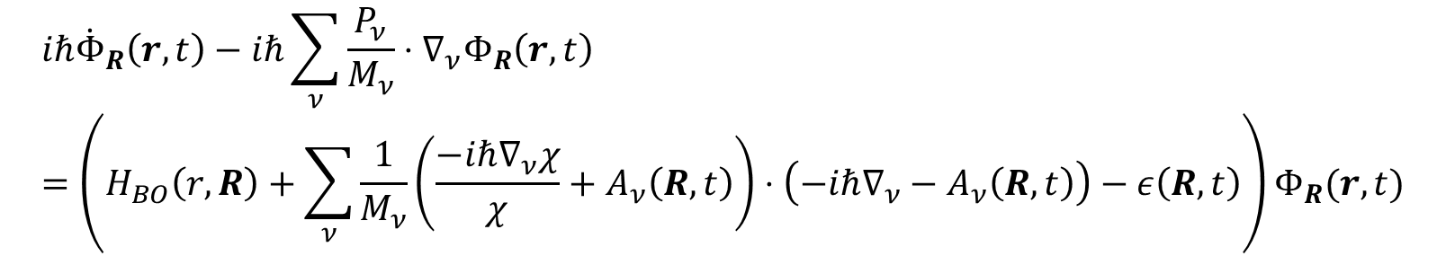
Towards the MQC equations
Approximation to the electronic TDSE
$$iℏ∂_{t}Φ_{R}\left(r,t\right)=\left(H_{BO}\left(r,R\right)+U_{en}^{coup}\left[Φ_{R},χ\right]−ε(R,t)\right)χ(R,t)$$
Neglecting the 2nd order terms generating the DBOC contribution
$$U_{en}^{coup}\left[Φ_{R},χ\right]≈\sum_{ν}{\frac{1}{M_{ν}}\left(\frac{−iℏ∇_{ν}χ}{χ}+A_{ν}(R,t)\right)⋅\left(−iℏ∇_{ν}−A_{ν}(R,t)\right)}$$
$$iℏ{\dot{Φ}}_{R}\left(r,t\right)−iℏ\sum_{ν}{\frac{P_{ν}}{M_{ν}}⋅∇_{ν}Φ_{R}\left(r,t\right)}=\left(H_{BO}\left(r,R\right)+\sum_{ν}{\frac{1}{M_{ν}}\left(\frac{−iℏ∇_{ν}χ}{χ}+A_{ν}\left(R,t\right)\right)⋅\left(−iℏ∇_{ν}−A_{ν}\left(R,t\right)\right)}−ε\left(R,t\right)\right)Φ_{R}(r,t)$$
Min, S. K.; Agostini, F.; Gross, E. K. U. PRL 2015, 115 (7), 073001.
Agostini, F.; Min, S. K.; Abedi, A.; Gross, E. K. U. JCTC 2016, 12 (5), 2127–2143.

Slide 18
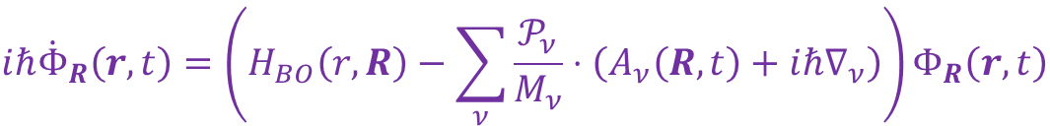
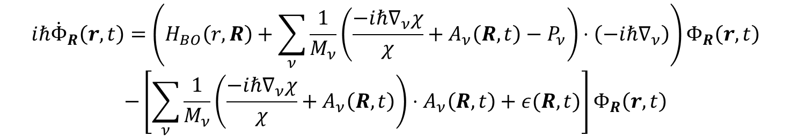
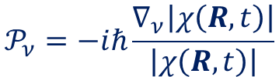
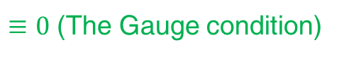
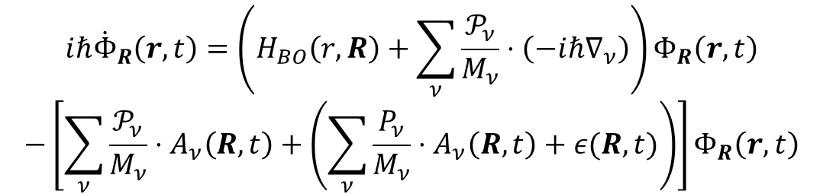
Towards the MQC equations
Approximation to the electronic TDSE
$$iℏ{\dot{Φ}}_{R}\left(r,t\right)=\left(H_{BO}\left(r,R\right)+\sum_{ν}{\frac{1}{M_{ν}}\left(\frac{−iℏ∇_{ν}χ}{χ}+A_{ν}\left(R,t\right)−P_{ν}\right)⋅\left(−iℏ∇_{ν}\right)}\right)Φ_{R}\left(r,t\right)$$
$$−\left[\sum_{ν}{\frac{1}{M_{ν}}\left(\frac{−iℏ∇_{ν}χ}{χ}+A_{ν}\left(R,t\right)\right)}⋅A_{ν}\left(R,t\right)+ε(R,t)\right]Φ_{R}\left(r,t\right)$$
Utilizing the polar form
Quantum momentum
$$\frac{−iℏ∇_{ν}χ}{χ}+A_{ν}\left(R,t\right)=∇_{ν}S+A_{ν}\left(R,t\right)−iℏ\frac{∇_{ν}\left|χ\left(R,t\right)\right|}{\left|χ\left(R,t\right)\right|}=P_{ν}+𝒫_{ν}$$
$$𝒫_{ν}=−iℏ\frac{∇_{ν}\left|χ\left(R,t\right)\right|}{\left|χ\left(R,t\right)\right|}$$
$$iℏ{\dot{Φ}}_{R}\left(r,t\right)=\left(H_{BO}\left(r,R\right)+\sum_{ν}{\frac{𝒫_{ν}}{M_{ν}}⋅\left(−iℏ∇_{ν}\right)}\right)Φ_{R}\left(r,t\right)$$
$$−\left[\sum_{ν}{\frac{𝒫_{ν}}{M_{ν}}}⋅A_{ν}\left(R,t\right)+\left(\sum_{ν}{\frac{P_{ν}}{M_{ν}}}⋅A_{ν}\left(R,t\right)+ε(R,t)\right)\right]Φ_{R}\left(r,t\right)$$
$≡0$ (The Gauge condition)
$$iℏ{\dot{Φ}}_{R}\left(r,t\right)=\left(H_{BO}\left(r,R\right)−\sum_{ν}{\frac{𝒫_{ν}}{M_{ν}}⋅\left(A_{ν}\left(R,t\right)+iℏ∇_{ν}\right)}\right)Φ_{R}\left(r,t\right)$$
Min, S. K.; Agostini, F.; Gross, E. K. U. PRL 2015, 115 (7), 073001.
Agostini, F.; Min, S. K.; Abedi, A.; Gross, E. K. U. JCTC 2016, 12 (5), 2127–2143.

Slide 19
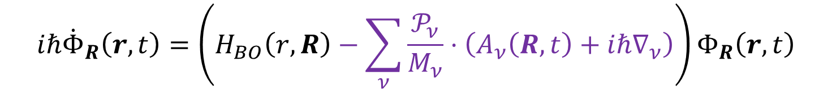
Towards the MQC equations
The XFMQC equations
$$iℏ{\dot{Φ}}_{R}\left(r,t\right)=\left(H_{BO}\left(r,R\right)−\sum_{ν}{\frac{𝒫_{ν}}{M_{ν}}⋅\left(A_{ν}\left(R,t\right)+iℏ∇_{ν}\right)}\right)Φ_{R}\left(r,t\right)$$
$$F_{ν}=−{\left\langle Φ_{R}\left(t\right)\left|∇_{ν}H_{BO}\right|Φ_{R}\left(t\right)\right\rangle }_{r}+\sum_{μ}{\frac{2i𝒫_{μ}}{ℏM_{μ}}⋅\left(A_{μ}\left(R,t\right)A_{ν}\left(R,t\right)−ℏ^{2}{\left\langle ∇_{μ}Φ_{R}\left(t\right) | ∇_{ν}Φ_{R}\left(t\right)\right\rangle }_{r}\right)}$$
Beyond the conventional Ehrenfest terms, the resulting coupled TDSEs explicitly contain the electron-nuclear correlation terms arising from the XF formalism, without adding any ad hoc decoherence correction.
Min, S. K.; Agostini, F.; Gross, E. K. U. PRL 2015, 115 (7), 073001.
Agostini, F.; Min, S. K.; Abedi, A.; Gross, E. K. U. JCTC 2016, 12 (5), 2127–2143.

Slide 20
Coupled-trajectory MQC approach (CTMQC)

Slide 21
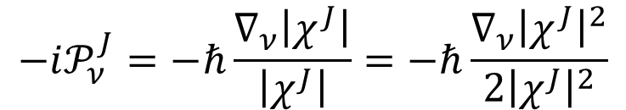
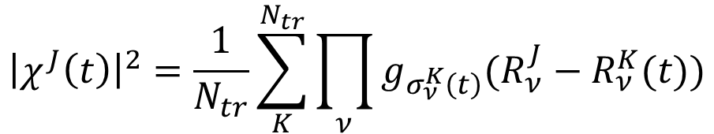
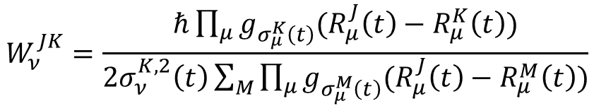
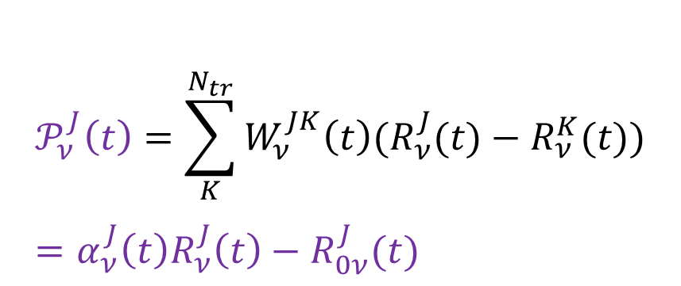
Coupled trajectory method (CTMQC)
The quantum momentum calculation
The nuclear density is reproduced by the ensemble of trajectories $\{R^{J}\left(t\right), P^{J}(t)\}$. It is expressed as Gaussian functions $\{g_{σ_{ν}^{J}\left(t\right)}\}$ to express the quantum momentum analytically.
$${\left|χ^{J}\left(t\right)\right|}^{2}=\frac{1}{N_{tr}}\sum_{K}^{N_{tr}}{\prod_{ν}{g_{σ_{ν}^{K}\left(t\right)}(R_{ν}^{J}−R_{ν}^{K}(t))}}$$
$$−i𝒫_{ν}^{J}=−ℏ\frac{∇_{ν}\left|χ^{J}\right|}{\left|χ^{J}\right|}=−ℏ\frac{∇_{ν}{\left|χ^{J}\right|}^{2}}{2{\left|χ^{J}\right|}^{2}}$$
$$𝒫_{ν}^{J}\left(t\right)=\sum_{K}^{N_{tr}}{W_{ν}^{JK}\left(t\right)(R_{ν}^{J}(t)−R_{ν}^{K}(t))}=α_{ν}^{J}\left(t\right)R_{ν}^{J}\left(t\right)−R_{0ν}^{J}(t)$$
$$W_{ν}^{JK}=\frac{ℏ\prod_{μ}{g_{σ_{μ}^{K}\left(t\right)}(R_{μ}^{J}\left(t\right)−R_{μ}^{K}\left(t\right))}}{2σ_{ν}^{K,2}\left(t\right)\sum_{M}{\prod_{μ}{g_{σ_{μ}^{M}\left(t\right)}(R_{μ}^{J}\left(t\right)−R_{μ}^{M}\left(t\right))}}}$$
Thus, the quantum momentum of each trajectory becomes a linear function constructed by the slope and y-intercept, which are computed through the trajectory ensemble.
Min, S. K.; Agostini, F.; Tavernelli, I.; Gross, E. K. U. JPCL. 2017, 8 (13), 3048–3055.
Agostini, F.; Min, S. K.; Abedi, A.; Gross, E. K. U. JCTC. 2016, 12 (5), 2127–2143.

Slide 22
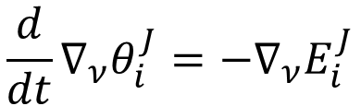
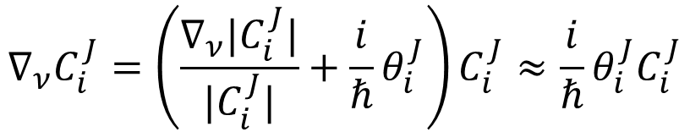
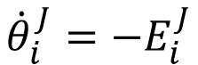
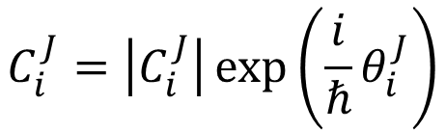
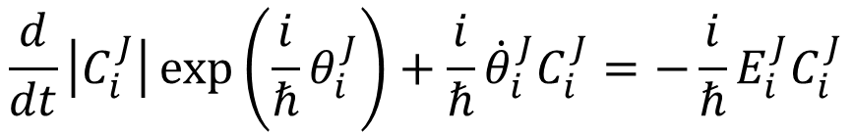
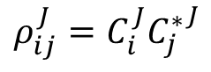
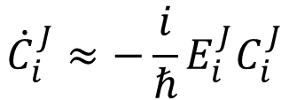
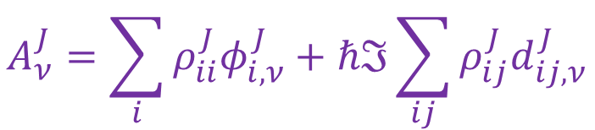
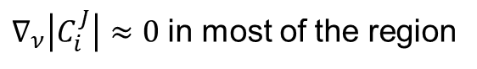
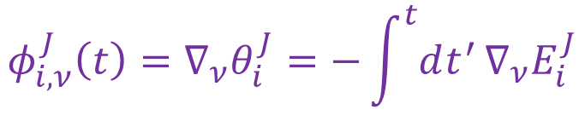
Coupled trajectory method (CTMQC)
TD vector potential calculation
In order to compute the TD vector potential, spatial derivative of the coefficients needs to be approximated.
$∇_{ν}\left|C_{i}^{J}\right|≈0$ in most of the region
$$C_{i}^{J}=\left|C_{i}^{J}\right|\exp\left(\frac{i}{ℏ}θ_{i}^{J}\right)$$
$${∇_{ν}C}_{i}^{J}=\left(\frac{∇_{ν}|C_{i}^{J}|}{|C_{i}^{J}|}+\frac{i}{ℏ}θ_{i}^{J}\right)C_{i}^{J}≈\frac{i}{ℏ}θ_{i}^{J}C_{i}^{J}$$
0
$${\dot{C}}_{i}^{J}≈−\frac{i}{ℏ}E_{i}^{J}C_{i}^{J}$$
$$\frac{d}{dt}\left|C_{i}^{J}\right|\exp\left(\frac{i}{ℏ}θ_{i}^{J}\right)+\frac{i}{ℏ}{\dot{θ}}_{i}^{J}C_{i}^{J}=−\frac{i}{ℏ}E_{i}^{J}C_{i}^{J}$$
$${\dot{θ}}_{i}^{J}=−E_{i}^{J}$$
$$\frac{d}{dt}∇_{ν}θ_{i}^{J}=−{∇_{ν}E}_{i}^{J}$$
$$φ_{i,ν}^{J}\left(t\right)=∇_{ν}θ_{i}^{J}=−\int^{t}{dt^{′}}∇_{ν}E_{i}^{J}$$
Phase gradient
$$A_{ν}^{J}=\sum_{i}{ρ_{ii}^{J}φ_{i,ν}^{J}}+ℏℑ\sum_{ij}{ρ_{ij}^{J}d_{ij,ν}^{J}}$$
cf. adiabatic density matrix
$$ρ_{ij}^{J}=C_{i}^{J}{C_{j}^{∗}}^{J}$$
Agostini, F.; Min, S. K.; Abedi, A.; Gross, E. K. U. JCTC. 2016, 12 (5), 2127–2143.
Agostini, F.; Abedi, A.; Suzuki, Y.; Min, S. K.; Maitra, N. T.; Gross, E. K. U. JCP. 2015, 142 (8), 084303.

Slide 23
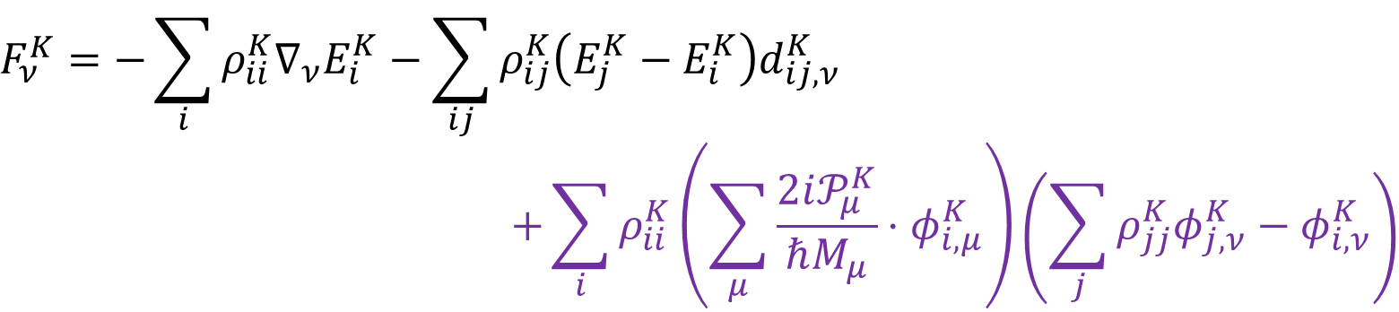
Coupled trajectory method (CTMQC)
Equations of motion (EOMs)
The electron-nuclear correlation beyond the Ehrenfest terms naturally appear in electronic and nuclear EOMs.
With the predefined trajectories, electronic and nuclear evolutions are conducted simultaneously. Through the quantum momentum, each trajectory is “connected”.
$${\dot{C}}_{i}^{K}=−\frac{i}{ℏ}E_{i}^{K}C_{i}^{K}−\sum_{j}{C_{j}^{K}\sum_{ν}{\frac{P_{ν}^{K}}{M_{ν}}⋅d_{ij,ν}^{K}}}+\sum_{ν}{\frac{i𝒫_{ν}^{K}}{ℏM_{ν}}⋅\left(\sum_{j}{{\left|C_{j}^{K}\right|}^{2}φ_{jν}^{K}}−φ_{iν}^{K}\right)}C_{i}^{K}$$
Electronic part
$$F_{ν}^{K}=−\sum_{i}{ρ_{ii}^{K}∇_{ν}E_{i}^{K}}−\sum_{ij}{ρ_{ij}^{K}\left(E_{j}^{K}−E_{i}^{K}\right)d_{ij,ν}^{K}}$$
$$+\sum_{i}{ρ_{ii}^{K}\left(\sum_{μ}{\frac{2i𝒫_{μ}^{K}}{ℏM_{μ}}}⋅φ_{i,μ}^{K}\right)}\left(\sum_{j}{ρ_{jj}^{K}φ_{j,ν}^{K}}−φ_{i,ν}^{K}\right)$$
Nuclear part
Agostini, F.; Min, S. K.; Abedi, A.; Gross, E. K. U. JCTC. 2016, 12 (5), 2127–2143.

Slide 24


Coupled trajectory method (CTMQC)
New electron-nuclear correlation compared to Ehrenfest/Surface hopping dynamics
A swarm of trajectories are propagated to construct nuclear quantum momentum
The phase gradients from adiabatic forces
Wavepacket splitting and (de)coherence are properly captured in the model Hamiltonian simulations.
Min, S. K.; Agostini, F.; Gross, E. K. U. PRL 2015, 115 (7), 073001.

Slide 25


Coupled trajectory method (CTMQC)
Applications to the molecular systems
Photochemistry of Oxirane; excited-state calculation with LR-TDDFT
Min, S. K.; Agostini, F.; Tavernelli, I.; Gross, E. K. U. JPCL. 2017, 8 (13), 3048–3055.

Slide 26


Coupled trajectory method (CTMQC)
More works…
Energy conservation through modifying the phase gradient calculation (CTMQC-E)
Simplified nuclear dynamics based on TSH (CTSH)
Arribas, E. V.; Ibele, L. M.; Lauvergnat, D.; Maitra, N. T.; Agostini, F. JCTC. 2023, 19 (21), 7787–7800.
Pieroni, C.; Agostini, F. JCTC. 2021, 17 (10), 5969–5991.

Slide 27
Independent-trajectory XF methods

Slide 28
Necessity of the independent-trajectory algorithm
The CTMQC algorithm is efficient, but it requires more cost than that in the conventional TSH method.
Simultaneous propagation of a swarm of trajectories
The NACV calculation for computing the decoherence force
The stability of the CTMQC calculation is sensitive to the excited-state calculation in each trajectory (Excited-state calculations need to be stable for all trajectories).
How can we simplify the force so that explicit NACV calculation is not obliged?
How to define the quantum momentum in the level of independent trajectory?

Slide 29


Surface hopping based on XF (SHXF)
Nuclear EOM: Based on the FSSH force, that is, the adiabatic force of an active state determined by the hopping process is employed to evolve nuclei.
Electronic EOM: Only electronic propagation contains the decoherence term.
To compute the quantum momentum in the independent-trajectory level, auxiliary trajectories are employed for each trajectory to estimate the overall nuclear wavepacket distribution.
$$P_{i→j}=\frac{2ℜ(ρ_{ij}\sum_{ν}{{\dot{R}}_{ν}⋅d_{ij,ν}})}{ρ_{ii}} Δt$$
$${\dot{C}}_{i}=−\frac{i}{ℏ}E_{i}C_{i}−\sum_{j}{C_{j}\sum_{ν}{\frac{P_{ν}}{M_{ν}}⋅d_{ij,ν}}}+\sum_{ν}{\frac{i𝒫_{ν}}{ℏM_{ν}}⋅\left(\sum_{j}{{\left|C_{j}\right|}^{2}φ_{jν}}−φ_{iν}\right)}C_{i}$$
Ha, J.-K.; Lee, I. S.; Min, S. K. JPCL. 2018, 9 (5), 1097–1104.
Agostini, F.; Min, S. K.; Abedi, A.; Gross, E. K. U. JCTC. 2016, 12 (5), 2127–2143.

Slide 30


Surface hopping based on XF (SHXF)
Auxiliary trajectory propagation
When the coherence criterion, that is, $ε<{\left|C_{i}\right|}^{2}<1−ε$, are satisfied for a state, the auxiliary trajectory is spawned for that state.
The initial aux. position $R_{i}$ is set to the real position at the spawning time $t_{i}$.
$$R_{i}\left(t_{i}\right)=R(t_{i})$$
The aux. momentum $P_{i}$ is set by rescaling $P_{i}=α_{i}P$ based on
the energy conservation.
$$\frac{1}{2}P_{i}^{T}M^{−1}P_{i}+E_{i}=\frac{1}{2}P^{T}M^{−1}P+E$$
The aux. position is propagated by the current aux. momentum.
$$R_{i}\left(t+Δt\right)=R_{i}\left(t\right)+M^{−1}P_{i}\left(t\right)Δt$$
When the coherence criterion is no longer satisfied,
or a hop occurs, aux. trajectories are destroyed.
Real trajectory
Aux. trajectory
$$R$$
Ha, J.-K.; Lee, I. S.; Min, S. K. JPCL. 2018, 9 (5), 1097–1104.

Slide 31


Surface hopping based on XF (SHXF)
Quantum momentum
The nuclear density is assumed to be combination of Gaussian functions having each aux. position as its center.
Eventually, the sign of quantum momentum is determined by the displacement between the real position and average position. By this procedure, each trajectory possesses its own quantum momentum constructed by its auxiliary trajectories.
$${\left|χ\right|}^{2}=\sum_{i}{{\left|χ_{i}\right|}^{2}}=\sum_{i}{N_{i}}\prod_{ν}{\exp\left(−\frac{{\left(R_{ν}−R_{i,ν}\right)}^{2}}{2σ_{i,ν}^{2}}\right)}$$
$$𝒫_{ν}≈\frac{iℏ}{2σ_{ν}^{2}}\left(R−\left\langle R_{ν}\right\rangle \right)≈\frac{iℏ}{2σ_{ν}^{2}}\left(R_{a,ν}−\sum_{i}{ρ_{ii}R_{i,ν}}\right)$$
Ha, J.-K.; Lee, I. S.; Min, S. K. JPCL. 2018, 9 (5), 1097–1104.

Slide 32


Surface hopping based on XF (SHXF)
Phase gradient
The phase gradient is computed by the momentum difference during the coherence.
Thus, quantum momentum and phase gradient become physical quantities in terms of the relative position and momentum.
$$φ_{i,ν}=−\int_{t_{i}}^{t}{dt^{′}}∇_{ν}E_{i}=\int_{t_{i}}^{t}{dt^{′}}F_{i}=\int_{t_{i}}^{t}{dP_{i}}$$
$$φ_{i,ν}(t)=P_{i}\left(t\right)−P_{i}(t_{i})$$
Ha, J.-K.; Lee, I. S.; Min, S. K. JPCL. 2018, 9 (5), 1097–1104.

Slide 33


Surface hopping based on XF (SHXF)
Decoherence correction through the electron-nuclear correlation term
The newly deduced electron-nuclear correlation contribution to the density is the following.
The direction of the decoherence is determined by the interplay between the relative position and momentum.
$${\dot{ρ}}_{ii}^{XF}=\sum_{ν}{\frac{2i𝒫_{ν}}{M_{ν}}⋅\sum_{j}{\left(φ_{j,ν}−φ_{i,ν}\right)ρ_{jj}ρ_{ii}}}$$
$${\dot{ρ}}_{ii}^{XF}=−\sum_{ν}{\frac{ℏ}{M_{ν}σ_{ν}}\left(R_{ν}−{⟨R}_{ν}⟩\right)⋅\sum_{j}{\left(φ_{j,ν}−φ_{i,ν}\right)ρ_{jj}ρ_{ii}}}$$
Ha, J.-K.; Lee, I. S.; Min, S. K. JPCL. 2018, 9 (5), 1097–1104.

Slide 34




Surface hopping based on XF (SHXF)
Auxiliary trajectory propagation & decoherence correction
< 0
$${\dot{ρ}}_{00}^{XF}=−\frac{ℏ}{Mσ}\left(R−⟨R⟩\right)⋅\left(φ_{1}−φ_{0}\right)ρ_{11}ρ_{00}$$
$${\dot{ρ}}_{11}^{XF}=−\frac{ℏ}{Mσ}\left(R−⟨R⟩\right)⋅\left(φ_{0}−φ_{1}\right)ρ_{00}ρ_{11}$$
Real trajectory
< 0
> 0
The electron-nuclear correlation acts as the decoherence correction, increasing $ρ_{11}$ and decreasing $ρ_{00}$.
Aux. trajectory
$$R$$
Ha, J.-K.; Lee, I. S.; Min, S. K. JPCL. 2018, 9 (5), 1097–1104.

Slide 35



Surface hopping based on XF (SHXF)
Auxiliary trajectory propagation & decoherence correction
< 0
$${\dot{ρ}}_{00}^{XF}=−\frac{ℏ}{Mσ}\left(R−⟨R⟩\right)⋅\left(φ_{1}−φ_{0}\right)ρ_{11}ρ_{00}$$
$${\dot{ρ}}_{11}^{XF}=−\frac{ℏ}{Mσ}\left(R−⟨R⟩\right)⋅\left(φ_{0}−φ_{1}\right)ρ_{00}ρ_{11}$$
> 0
> 0
Aux. trajectory
The electron-nuclear correlation acts as the decoherence correction, increasing $ρ_{00}$ and decreasing $ρ_{11}$.
Real trajectory
Decoherence facilitates the population transfer to the active state → The active state serves as the pointer state!
$$R$$
Ha, J.-K.; Lee, I. S.; Min, S. K. JPCL. 2018, 9 (5), 1097–1104.
Shu, Y.; Truhlar, D. G. JCTC. 2023, 19 (2), 380–395.

Slide 36



Surface hopping based on XF (SHXF)
Branching correction on the auxiliary trajectory propagation
When the dynamics encounters the classical turning point, there are some difficulties for defining the auxiliary momenta
Case I. An auxiliary trajectory encounters the turning point.
In this case, the auxiliary trajectory needs to reflect. However, the aux. momentum is computed by the positive scaling of the real momentum. Thus, a special treatment is necessary.
$$E_{tot}$$
$$P_{i}=α_{i}\left(>0\right)P$$
Aux. trajectory
Inspired by the BCSH method, one can the density of the auxiliary state and initialize the auxiliary project out trajectory.
Real trajectory
$$R$$
Arribas, E. V.; Vindel-Zandbergen, P.; Roy, S.; Maitra, N. T. PCCP. 2023, 25 (38), 26380–26395.
Xu, J.; Wang, L. JCP. 2019, 150 (16), 164101.

Slide 37
Surface hopping based on XF (SHXF)
Branching correction on the auxiliary trajectory propagation
When the dynamics encounters the classical turning point, there are some difficulties for defining the auxiliary momenta
Case II. The real trajectory encounters the turning point.
In this case, the auxiliary trajectory would experience abrupt momentum reversal, which could cause a wrong decoherence correction.
$$E_{tot}$$
Here, one can collapse the state to the active state. The criterion for the turning point is based on the BCSH turning point descriptor.
Real trajectory
$F^{T}\left(t+Δt\right)P_{i}\left(t+Δt\right)⋅F^{T}\left(t+Δt\right)P_{i}\left(t\right)<0$ $⇒$ turning point
Aux. trajectory
$$R$$
Ha, J.-K.; Min, S. K. JCP. 2022, 156 (17), 174109.
Xu, J.; Wang, L. JCP. 2019, 150 (16), 164101.

Slide 38


Surface hopping based on XF (SHXF)
Independent-trajectory MQC approach based on TSH
Proper description of multiple crossing in the NaI pump-probe experiment modeling
Excited-state dynamics of CH₂NH₂⁺ at ambient temperature (S₂ → S₁ → S₀)
NaI Hamiltonian
Photochemistry of CH₂NH₂⁺
bnd.
dissoc.
Ha, J.-K.; Lee, I. S.; Min, S. K. JPCL. 2018, 9 (5), 1097–1104.

Slide 39


Surface hopping based on XF (SHXF)
Applications to the molecular systems
Photoisomerization of molecular rotors
Filatov, M.; Paolino, M.; Min, S. K.; Kim, K. S. JPCL. 2018, 9 (17), 4995–5001.

Slide 40


Surface hopping based on XF (SHXF)
More works…
Study on multistate crossing through the LVC model of an uracil cation with SHXF
Overall review of the independent-trajectory XF methods including SHXF
Vindel-Zandbergen, P.; Matsika, S.; Maitra, N. T. JPCL. 2022, 13 (7), 1785–1790.
Han, D.; Akimov, A. V. JCTC. 2024, 20 (12), 5022–5042.

Slide 41


Mixed quantum-classical based on XF (MQCXF)
Recovery of the decoherence force in the independent-trajectory XF method
How about employing the decoherence force derived in the CTMQC equations as well in the independent-trajectory level?
However, for more reliable results, the energy conservation of the XF force needs to be addressed.
$${\dot{C}}_{i}=−\frac{i}{ℏ}E_{i}C_{i}−\sum_{j}{C_{j}\sum_{ν}{\frac{P_{ν}}{M_{ν}}⋅d_{ij,ν}}}+\sum_{ν}{\frac{i𝒫_{ν}}{ℏM_{ν}}⋅\left(\sum_{j}{{\left|C_{j}\right|}^{2}φ_{jν}}−φ_{iν}\right)}C_{i}$$
$$F_{ν}=−\sum_{i}{ρ_{ii}∇_{ν}E_{i}}−\sum_{ij}{ρ_{ij}\left(E_{j}−E_{i}\right)d_{ij,ν}}$$
$$+\sum_{ij}{ρ_{ii}ρ_{jj}\left[\sum_{μ}{\frac{2i𝒫_{μ}}{ℏM_{μ}}}⋅\left(φ_{j,μ}−φ_{i,μ}\right)\right]φ_{i,ν}}$$
Ha, J.-K.; Min, S. K. JCP. 2022, 156 (17), 174109.

Slide 42





Mixed quantum-classical based on XF (MQCXF)
Modified phase gradient calculation
For the energy conservation, the modified phase gradient is utilized in MQCXF.
$${\dot{E}}_{tot}=\sum_{ν}{F_{ν}⋅{\dot{R}}_{ν}}+\sum_{i}{\left({\dot{ρ}}_{ii}E_{i}+ρ_{ii}\sum_{ν}{∇_{ν}E_{i}⋅{\dot{R}}_{ν}}\right)}=\sum_{ij}{ρ_{ii}ρ_{jj}}\left[\sum_{μ}{\frac{𝒫_{μ}}{ℏM_{μ}}⋅\left(φ_{i,μ}−φ_{j,μ}\right)}\right]\left[E_{i}−E_{j}+\sum_{ν}{\left(φ_{i,ν}−φ_{j,ν}\right)⋅{\dot{R}}_{ν}}\right]\overset{!}{=}0$$
$$E_{i}−E_{j}+\sum_{ν}{\left(φ_{i,ν}−φ_{j,ν}\right)⋅{\dot{R}}_{ν}}=0$$
$$φ_{i,ν}−φ_{j,ν} =−\frac{E_{i}−E_{j}}{\sum_{ν}{n_{ν}⋅{\dot{R}}_{ν}}}n_{ν}$$
$$φ_{i,ν}−φ_{j,ν} =−\frac{E_{i}−E_{j}}{2E_{kin}}P_{ν}$$
The energy-based phase approximation
$$n_{ν}:=P_{ν}$$
Ha, J.-K.; Min, S. K. JCP. 2022, 156 (17), 174109.

Slide 43


Time-dependent Gaussian widths
Time-dependent Gaussian width approximations
It is likely that the nuclear wavepacket width would change during the dynamics. In order to consider those change in the quantum momentum calculation, one may apply the time-dependent width.
Schwartz scheme [Bedard-Hearn, M. J.; Larsen, R. E.; Schwartz, B. J. JCP. 2005, 123 (23), 234106.]
Subotnik scheme [Subotnik, J. E. JPCA. 2011, 115 (44), 12083–12096.]
$$σ_{ν}^{−2}\left(t\right)={\left(\frac{{\left(w_{ν}/Bohr\right)}^{2}}{2λ_{D,ν}\left(t\right)}\right)}^{2}={\left(\frac{{\left(w_{ν}/Bohr\right)}^{2}P_{ν}}{4πℏ}\right)}^{2}$$
$$σ_{ij,ν}^{−2}\left(t\right)=ℏ\frac{|R_{i,ν}−R_{j,ν}|}{|P_{i,ν}−P_{j,ν}|}$$
Ha, J.-K.; Min, S. K. JCP. 2022, 156 (17), 174109.
Han, D.; Akimov, A. V. JCTC. 2024, 20 (12), 5022–5042.

Slide 44
Implementation of the XF methods in Libra

Slide 45

The XF methods in Libra
Libra provides SHXF, MQCXF and MFXF (neglect of the XF force in MQCXF).
Phase gradient calculation is computed by the momentum difference in SHXF, and by the energy-based approximation in MQCXF and MFXF.
Options for addressing the turning points in the auxiliary propagation such the branching correction and other heuristics.
Various Gaussian widths approximations including the DOF-resolved width and td width such as Schwartz and Subotnik’s.
Method | Electronic EOM | Nuclear force | Velocity rescaling after a hop | Energy conservation
SHXF | $$H_{BO}+H_{XF}$$ | Active-state force | Yes | Yes
MQCXF |  | $$F_{MF}+F_{XF}$$ | No
MFXF |  | $$F_{MF}$$ |  | No
Han, D.; Akimov, A. V. JCTC. 2024, 20 (12), 5022–5042.

Slide 46







The XF methods in Libra
Electronic propagation in the local diabatization
Under the XF ansatz
$$iℏ\left|Φ_{R}\left(t\right)\right\rangle =[{\hat{H}}_{BO}\left(R\left(t\right)\right)+{\hat{H}}_{XF}\left(R,t\right)]\left|Φ_{R}\left(t\right)\right\rangle$$
$$\left|Ψ\left(R,t\right)\right\rangle =χ\left(R,t\right)|Φ_{R}\left(t\right)⟩$$
$${\hat{H}}_{XF}=−𝓟^{T}M^{−1}\left[A+iℏ∇\right]=−iℏ𝓟^{T}M^{−1}[|∇Φ_{R}⟩⟨Φ_{R}|+|Φ_{R}⟩⟨∇Φ_{R}|]$$
[Han, D.; Ha, J.-K.; Min, JCTC. 2023, 19 (8), 2186–2197.]
Applying the Trotter splitting approach within the generalized local diabatization scheme,
Shakiba, M.; Akimov, A. V. Theor. Chem. Acc. 2023, 142 (8), 68.
$$C^{′}=U_{XF}\left(C\left(t\right);\frac{Δt}{2}\right)C(t)$$
Granucci, G.; Persico, M.; Toniolo, A. JCP. 2001, 114 (24), 10608–10615.
$$U_{MF}\left(Δt\right)=\exp\left(−i\frac{H_{BO}\left(t\right)+T^{+}H_{BO}\left(t+Δt\right)T}{2ℏ}Δt\right)$$
$$C^{′′}=TU_{MF}\left(Δt\right)C′$$
$$C(t+Δt)=U_{XF}\left(C^{′′};\frac{Δt}{2}\right)C′$$
$$U_{XF}\left(C\left(t\right);Δt\right)=\exp\left(−i\frac{H_{XF}(C(t))}{2ℏ}Δt\right)$$
Han, D.; Akimov, A. V. JCTC. 2024, 20 (12), 5022–5042.

Slide 47


The XF methods in Libra
Schematics and flowchart
Han, D.; Akimov, A. V. JCTC. 2024, 20 (12), 5022–5042.

